Slide 1
Design of a CPU FPGA-Based in Verilog

Slide 2
Supervisor:
Prof. Fadi Shahroury
Done by:
Student Name: Abdulaziz Abusaada
Student Name: Aseel Jaber
Student Name: Marya Aldweik

Slide 3
Table of contents
01
02
03
04
Motivation
Architecture
Design
Ending

Slide 4
01
Motivation

Slide 5

What is our project?
Designing a microcontroller based on Verilog with a 25 MHz frequency and 16-bit operating system, the foundation of our project is to build the microcontroller from the universal NAND gate.

Slide 6

What we are using
RISC CPU architecture
Verilog Hardware description language.
open-source, simple, and elegant instruction set architecture making it ideal choice for educational and FPGA-based projects.

Slide 7
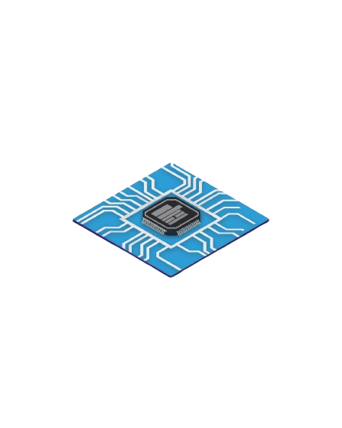
What is Microcontroller?

Slide 8
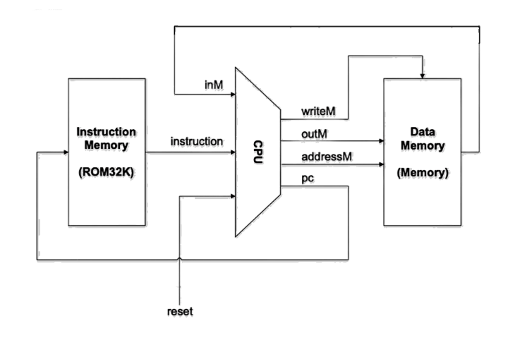
Microcontroller
It is a small computer used in embedded systems designed to do a specific task and it includes a memory, CPU, and i/o ports all in a single chip.

Slide 9
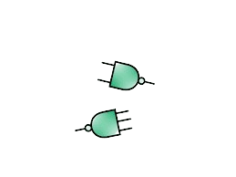
NAND gate is the foundation of our project

Slide 10
Why we choose NAND gate
Least Power Consumption
Transistor Size
Relationship between Power, Size, and Frequency
Parallel Pmos and Series Nmos

Slide 11
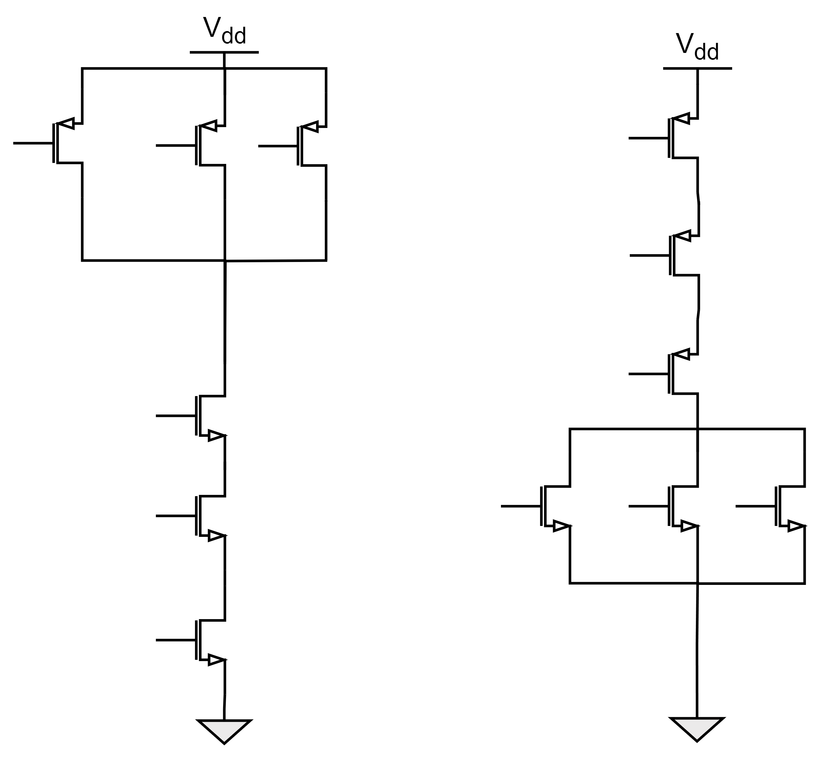
Why NAND not NOR gate

Slide 12
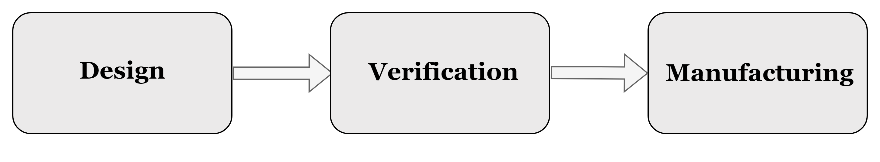
Manufacturing process
We choose FPGAs because they are affordable and freely available as open-source hardware, which is consistent with our values of efficacy and community-driven development.

Slide 13
Our achievement:
Week 01
Week 02
Week 03
Week 04
Using HDL
Elementary logic gates
16-bit variants
Multi-way variants
Using Verilog
Elementary logic gates
16-bit variants
Multi-way variants
Building ALU using Verilog and HDL
Building a Bit, Register and Pc counter using Verilog and HDL.
Week 06
week 05
Building ROM, RAM and Memory using Verilog .
Building CPU using Verilog.

Slide 14
2
Architecture

Slide 15
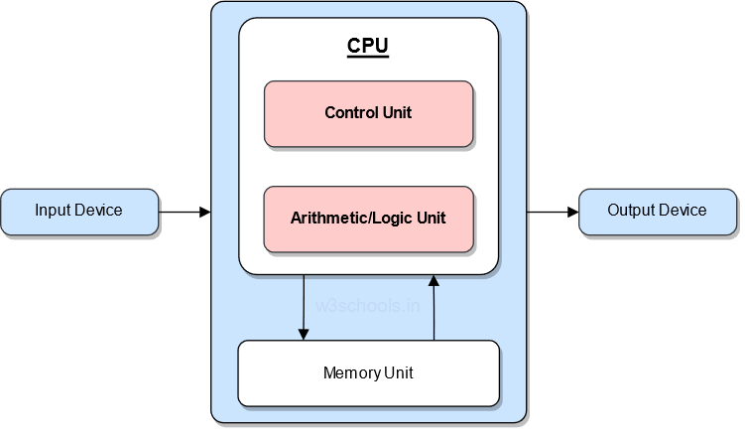
Computer system
A microprocessor system consists of data input, storage, processing and output devices, under the control of a CPU.

Slide 16
The Hack Computer
A 16-bit machine consisting of the following elements:
Both memory chips are 16-bit wide and have 15-bit address space.

Slide 17
The Hack Computer
A 16-bit machine consisting of the following elements:
-Data memory : RAM – an addressable sequence of registers
-Instruction memory : ROM – an addressable sequence of registers
-Registers : D, A, M, where M stands for RAM[A]
-Processing : ALU, capable of computing various functions
-Program counter : PC, holding an address
-Control : The ROM is loaded with a sequence of 16-bit instructions, one per memory location, beginning at address 0.
-Instruction set : Two instructions: A-instruction, C-instruction.

Slide 18
The Instructions
A-Instruction:
Entering a constant value ( A = value)
Selecting a RAM location ( register = RAM[A])
Selecting a ROM location ( PC = A )
C-Instruction:
Compute the value of comp
Store the result in dest
If (the condition jump compares to zero is true), goto the instruction at ROM[A].

Slide 19
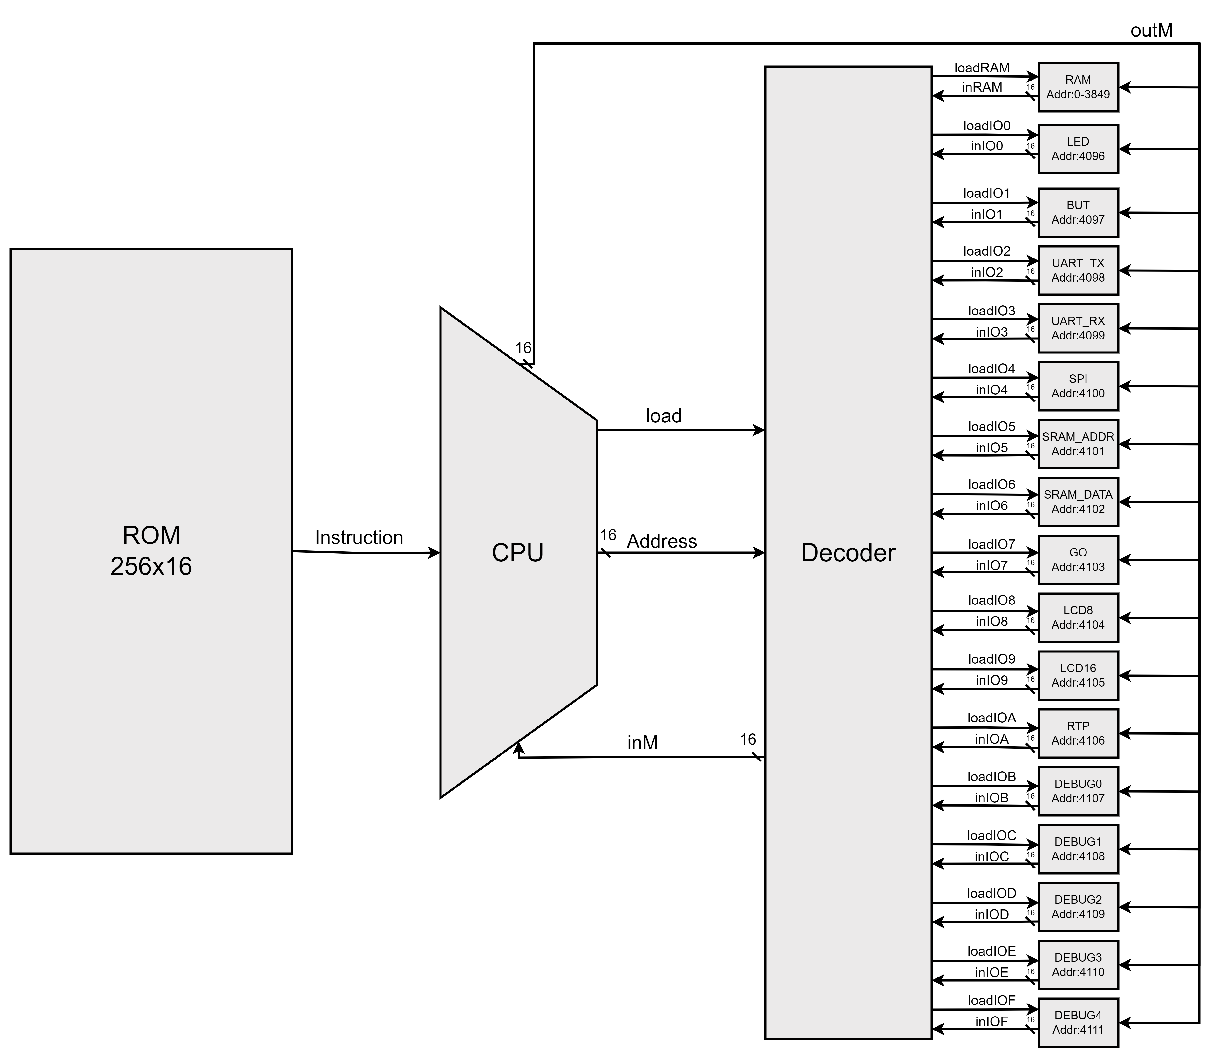
Memory

Slide 20

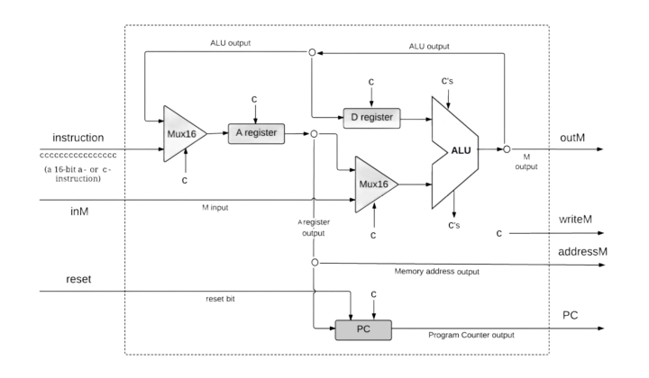
CPU

Slide 21
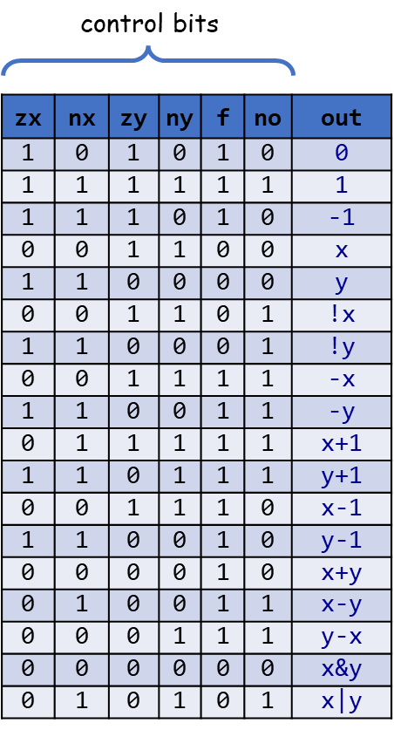
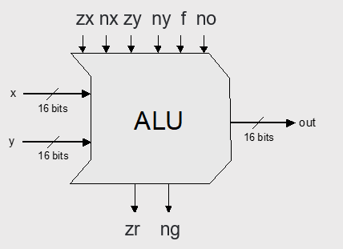
The Hack ALU
if (out == 0) then zr = 1, else zr = 0
if (out < 0) then ng = 1, else ng = 0
These two control bits will come into play when we build the complete computer’s architecture.

Slide 22
4
Design

Slide 23
The Hack Computer
A 16-bit machine consisting of the following elements:
Both memory chips are 16-bit wide and have 15-bit address space.

Slide 24
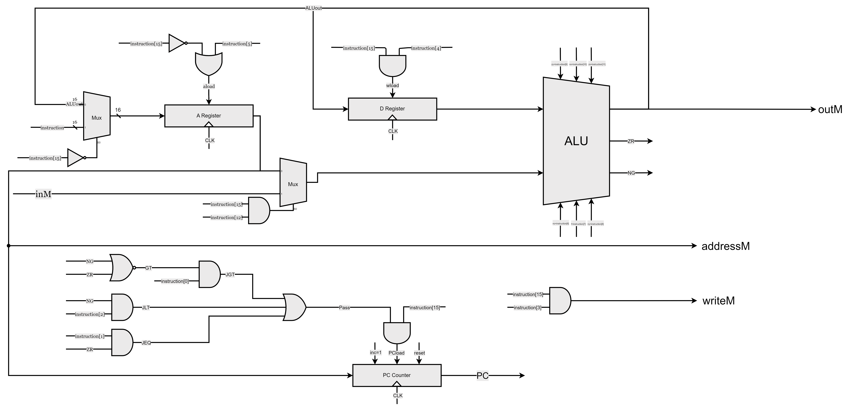
CPU

Slide 25
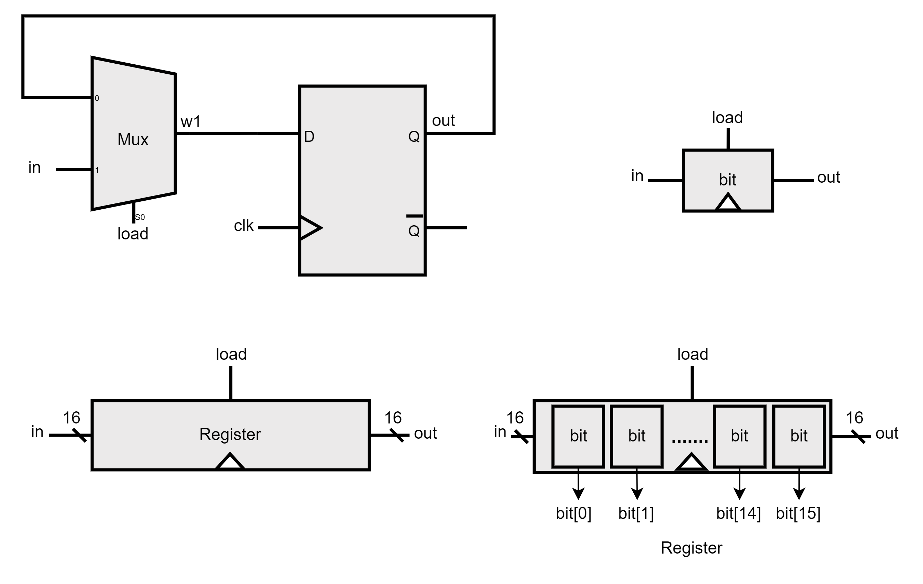
Bit - Register

Slide 26
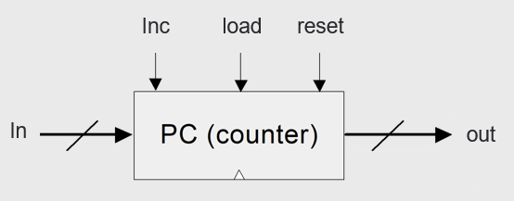
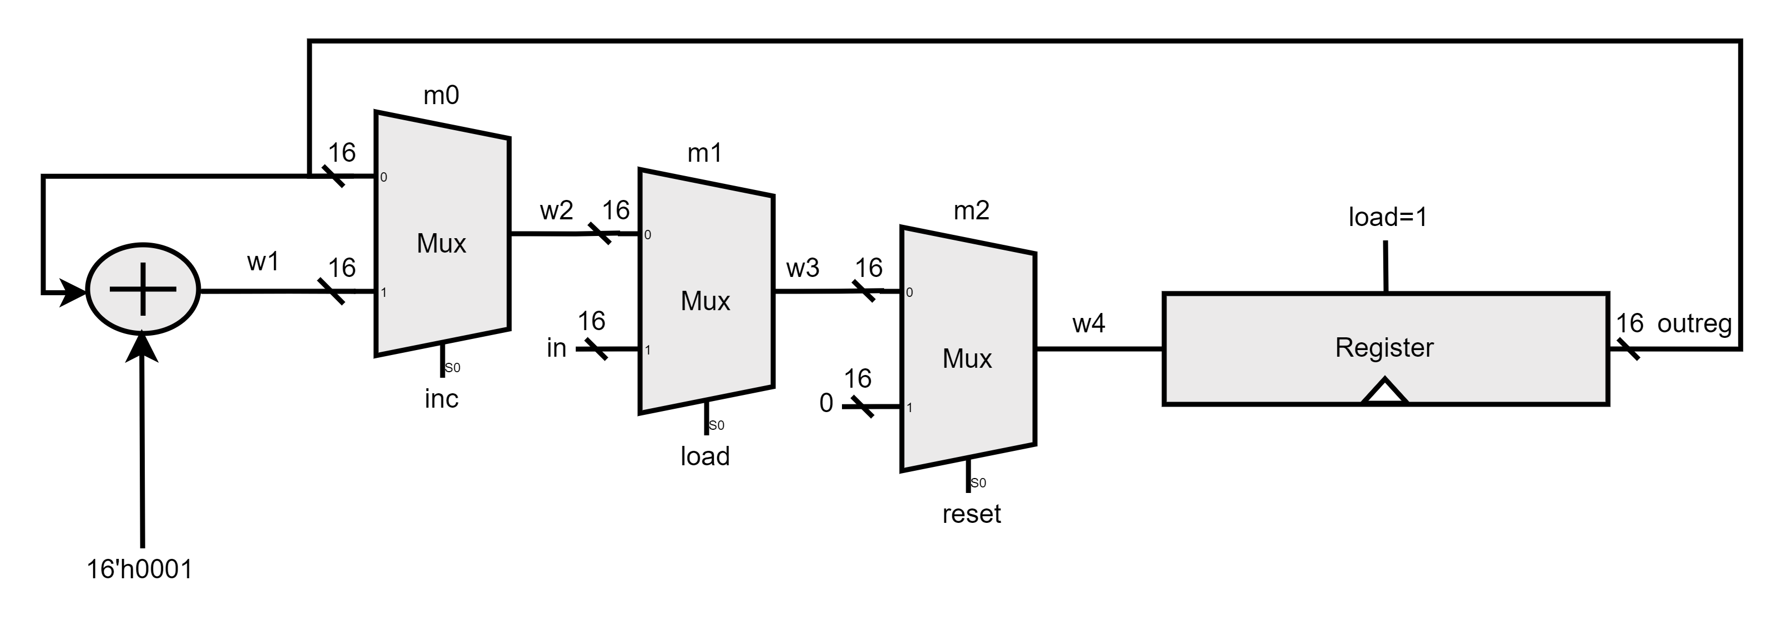
PC

Slide 27
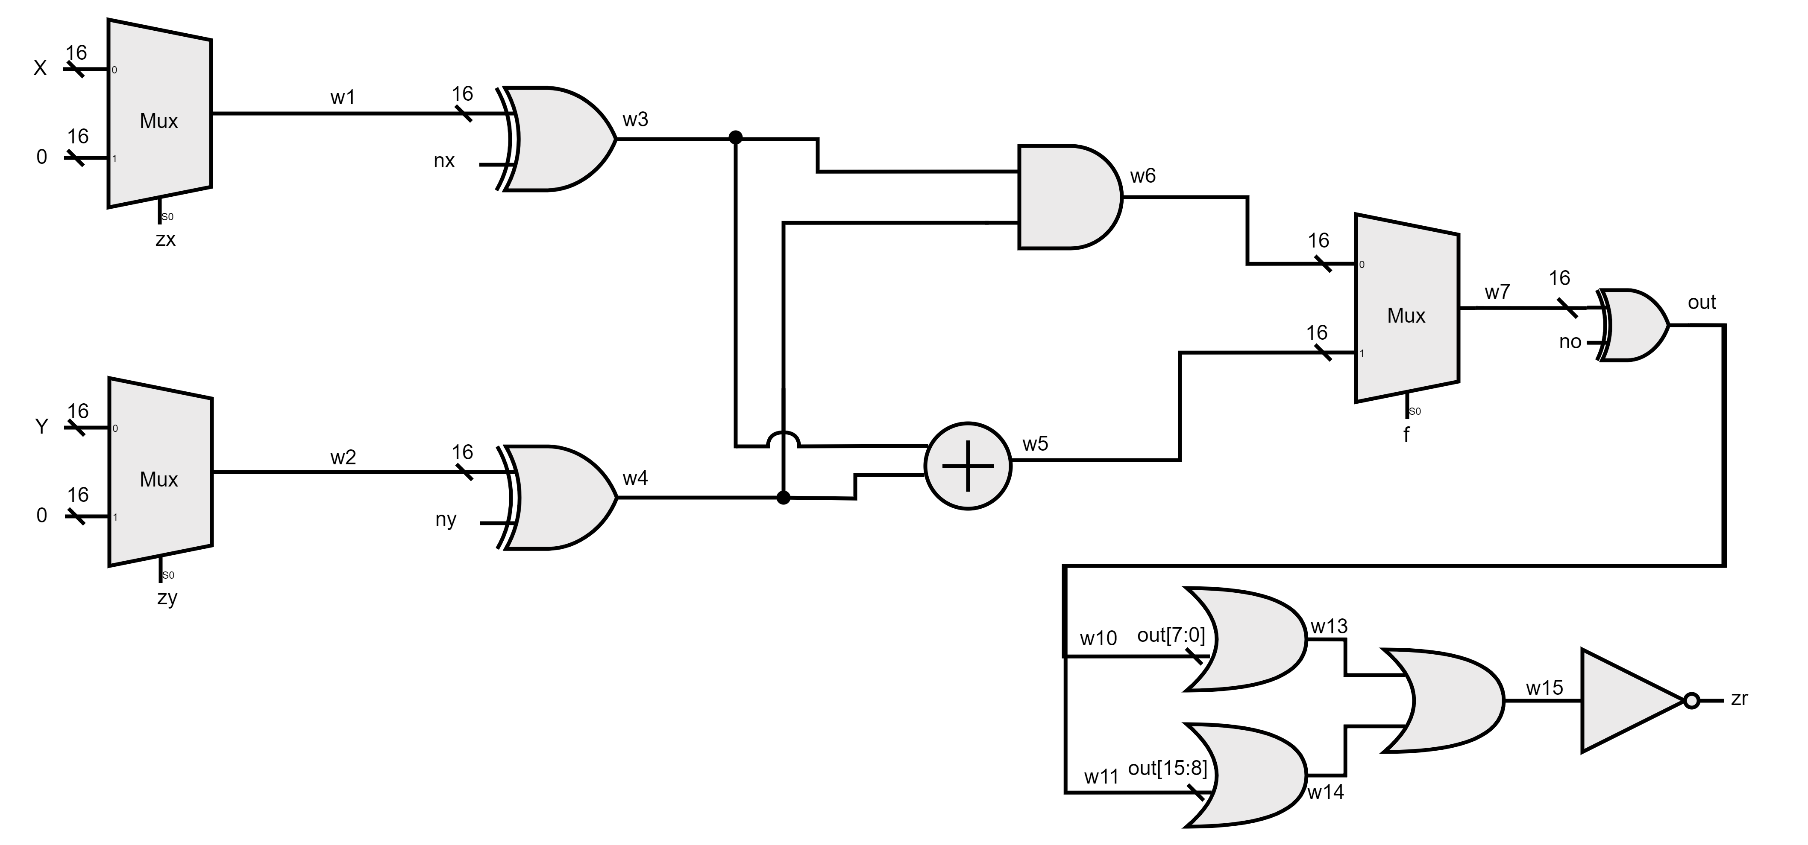
The Hack ALU
if (out == 0) then zr = 1, else zr = 0
if (out < 0) then ng = 1, else ng = 0
These two control bits will come into play when we build the complete computer’s architecture.

Slide 28
Memory

Slide 29
RAM

Slide 30
Elementary logic gates
Basic gates build using universal NAND gate

Slide 31
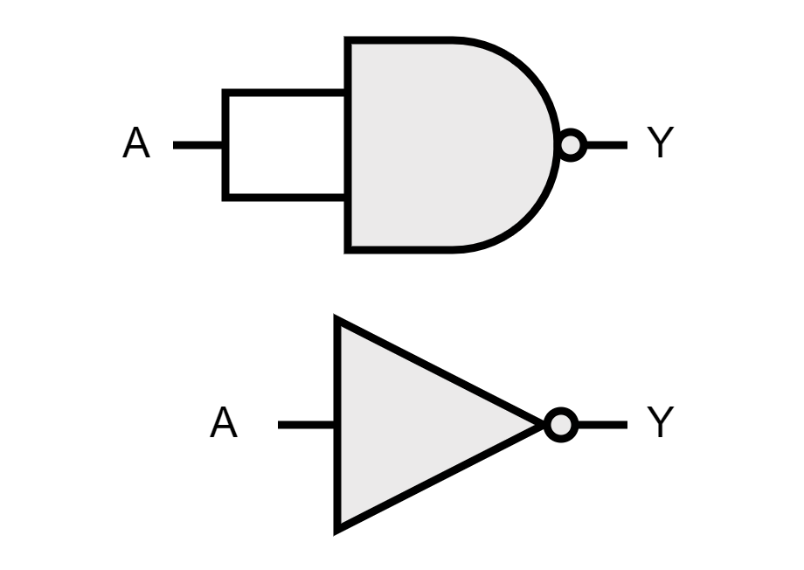
NOT Gate
We build NOT gate by connecting both inputs of NAND gate to the input signal.

Slide 32
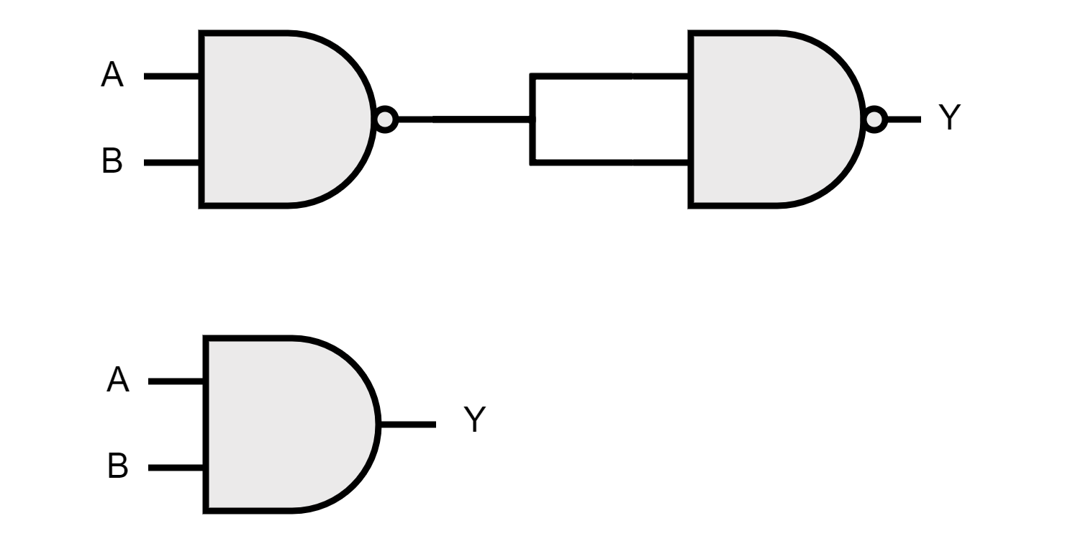
AND Gate
We build an AND gate by connecting the two inputs A and B to a NAND gate and then connecting the result to both inputs of the NAND gate.

Slide 33
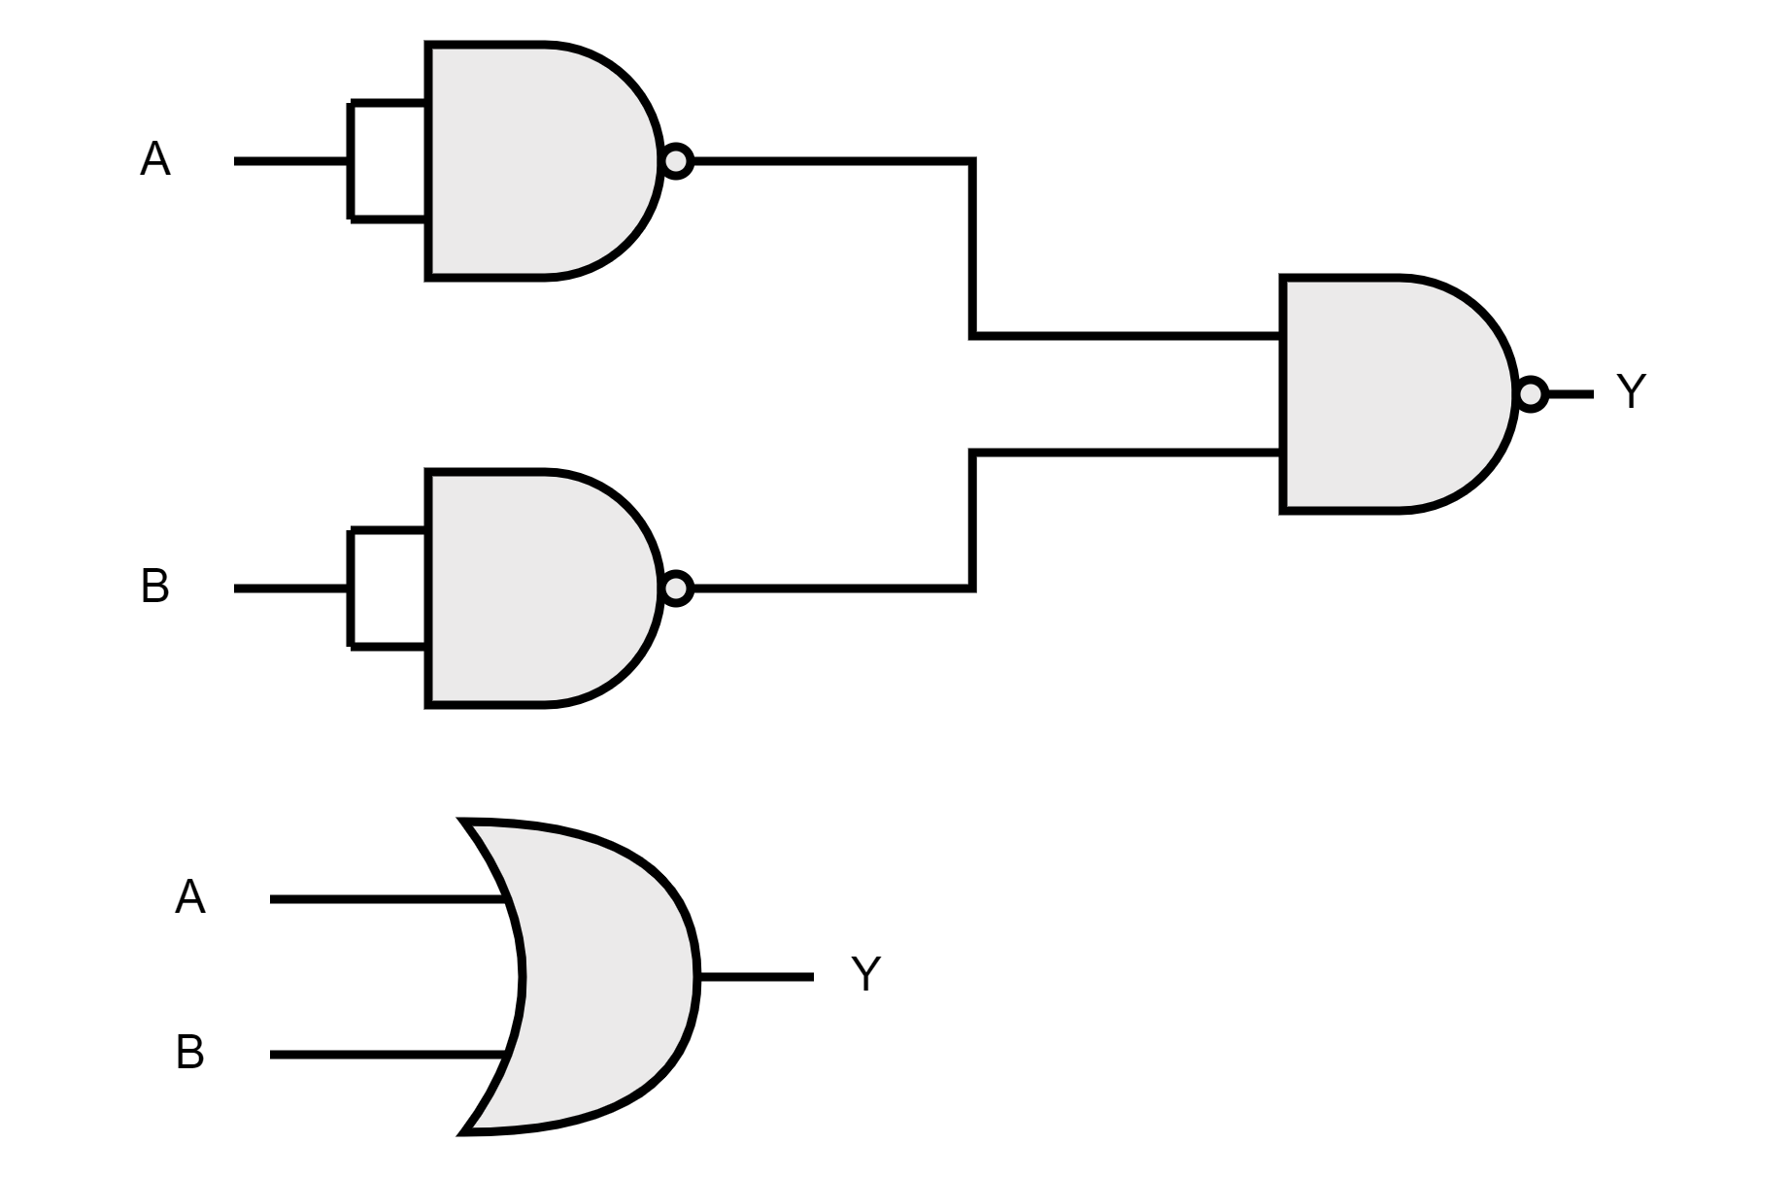
OR Gate
We build an OR gate by taking the NAND of two NAND gates where each input is connected to the same input signal (A or B).

Slide 34
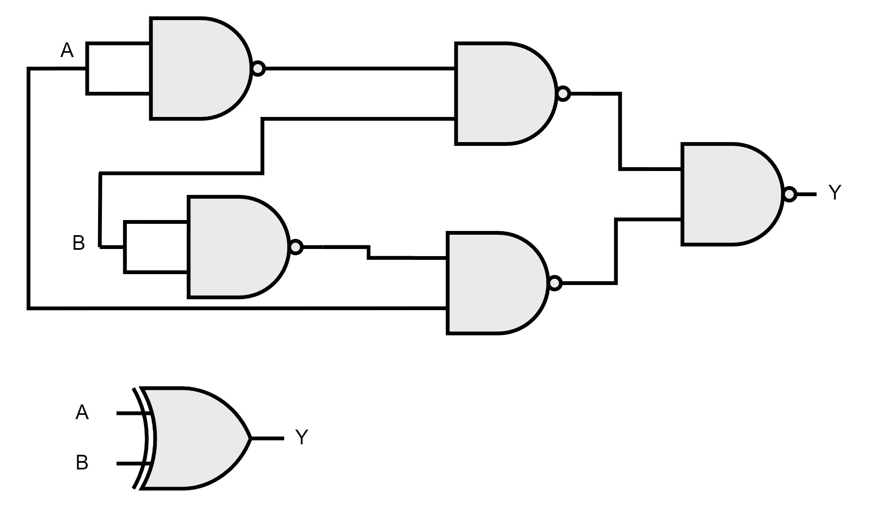
XOR Gate
We build an XOR gate by using NAND gates to construct the inputs and intermediate signals so that the final NAND operation produces an XOR gate.

Slide 35
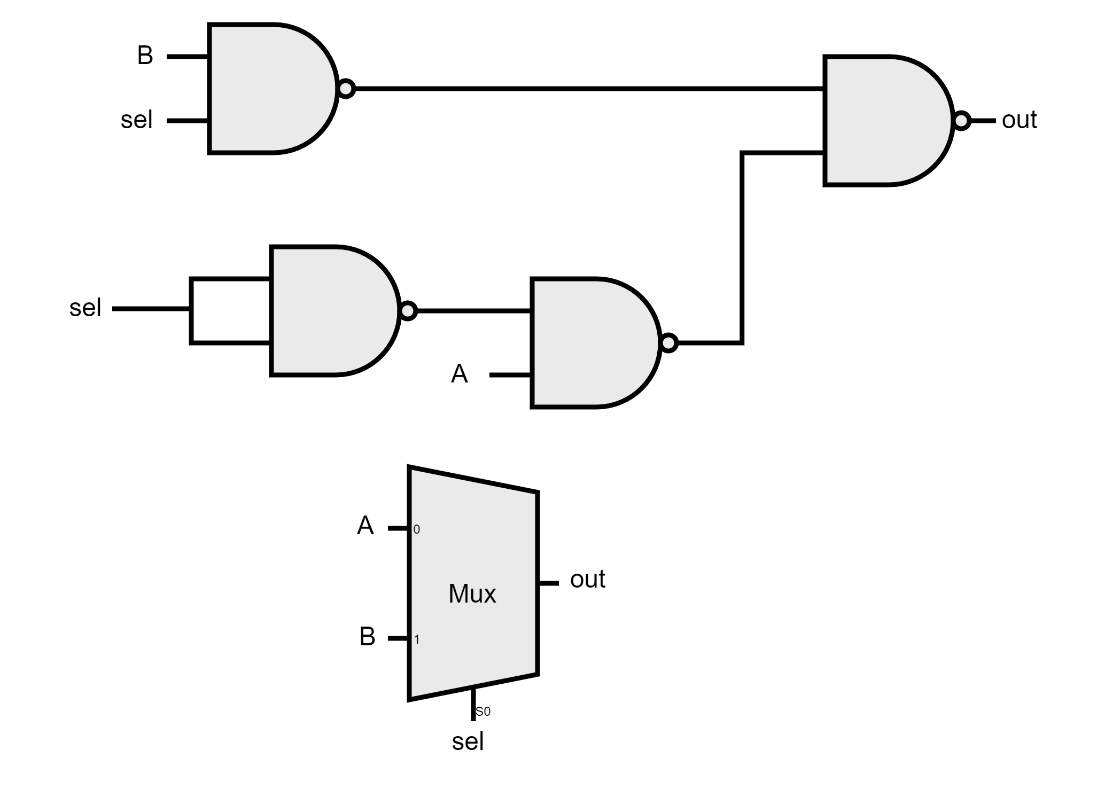
MUX Gate
We build a MUX using 4 NAND gates. We connect A to an inverted selection line, B to a non-inverted selection line, and then combine the results using another NAND gate.

Slide 36
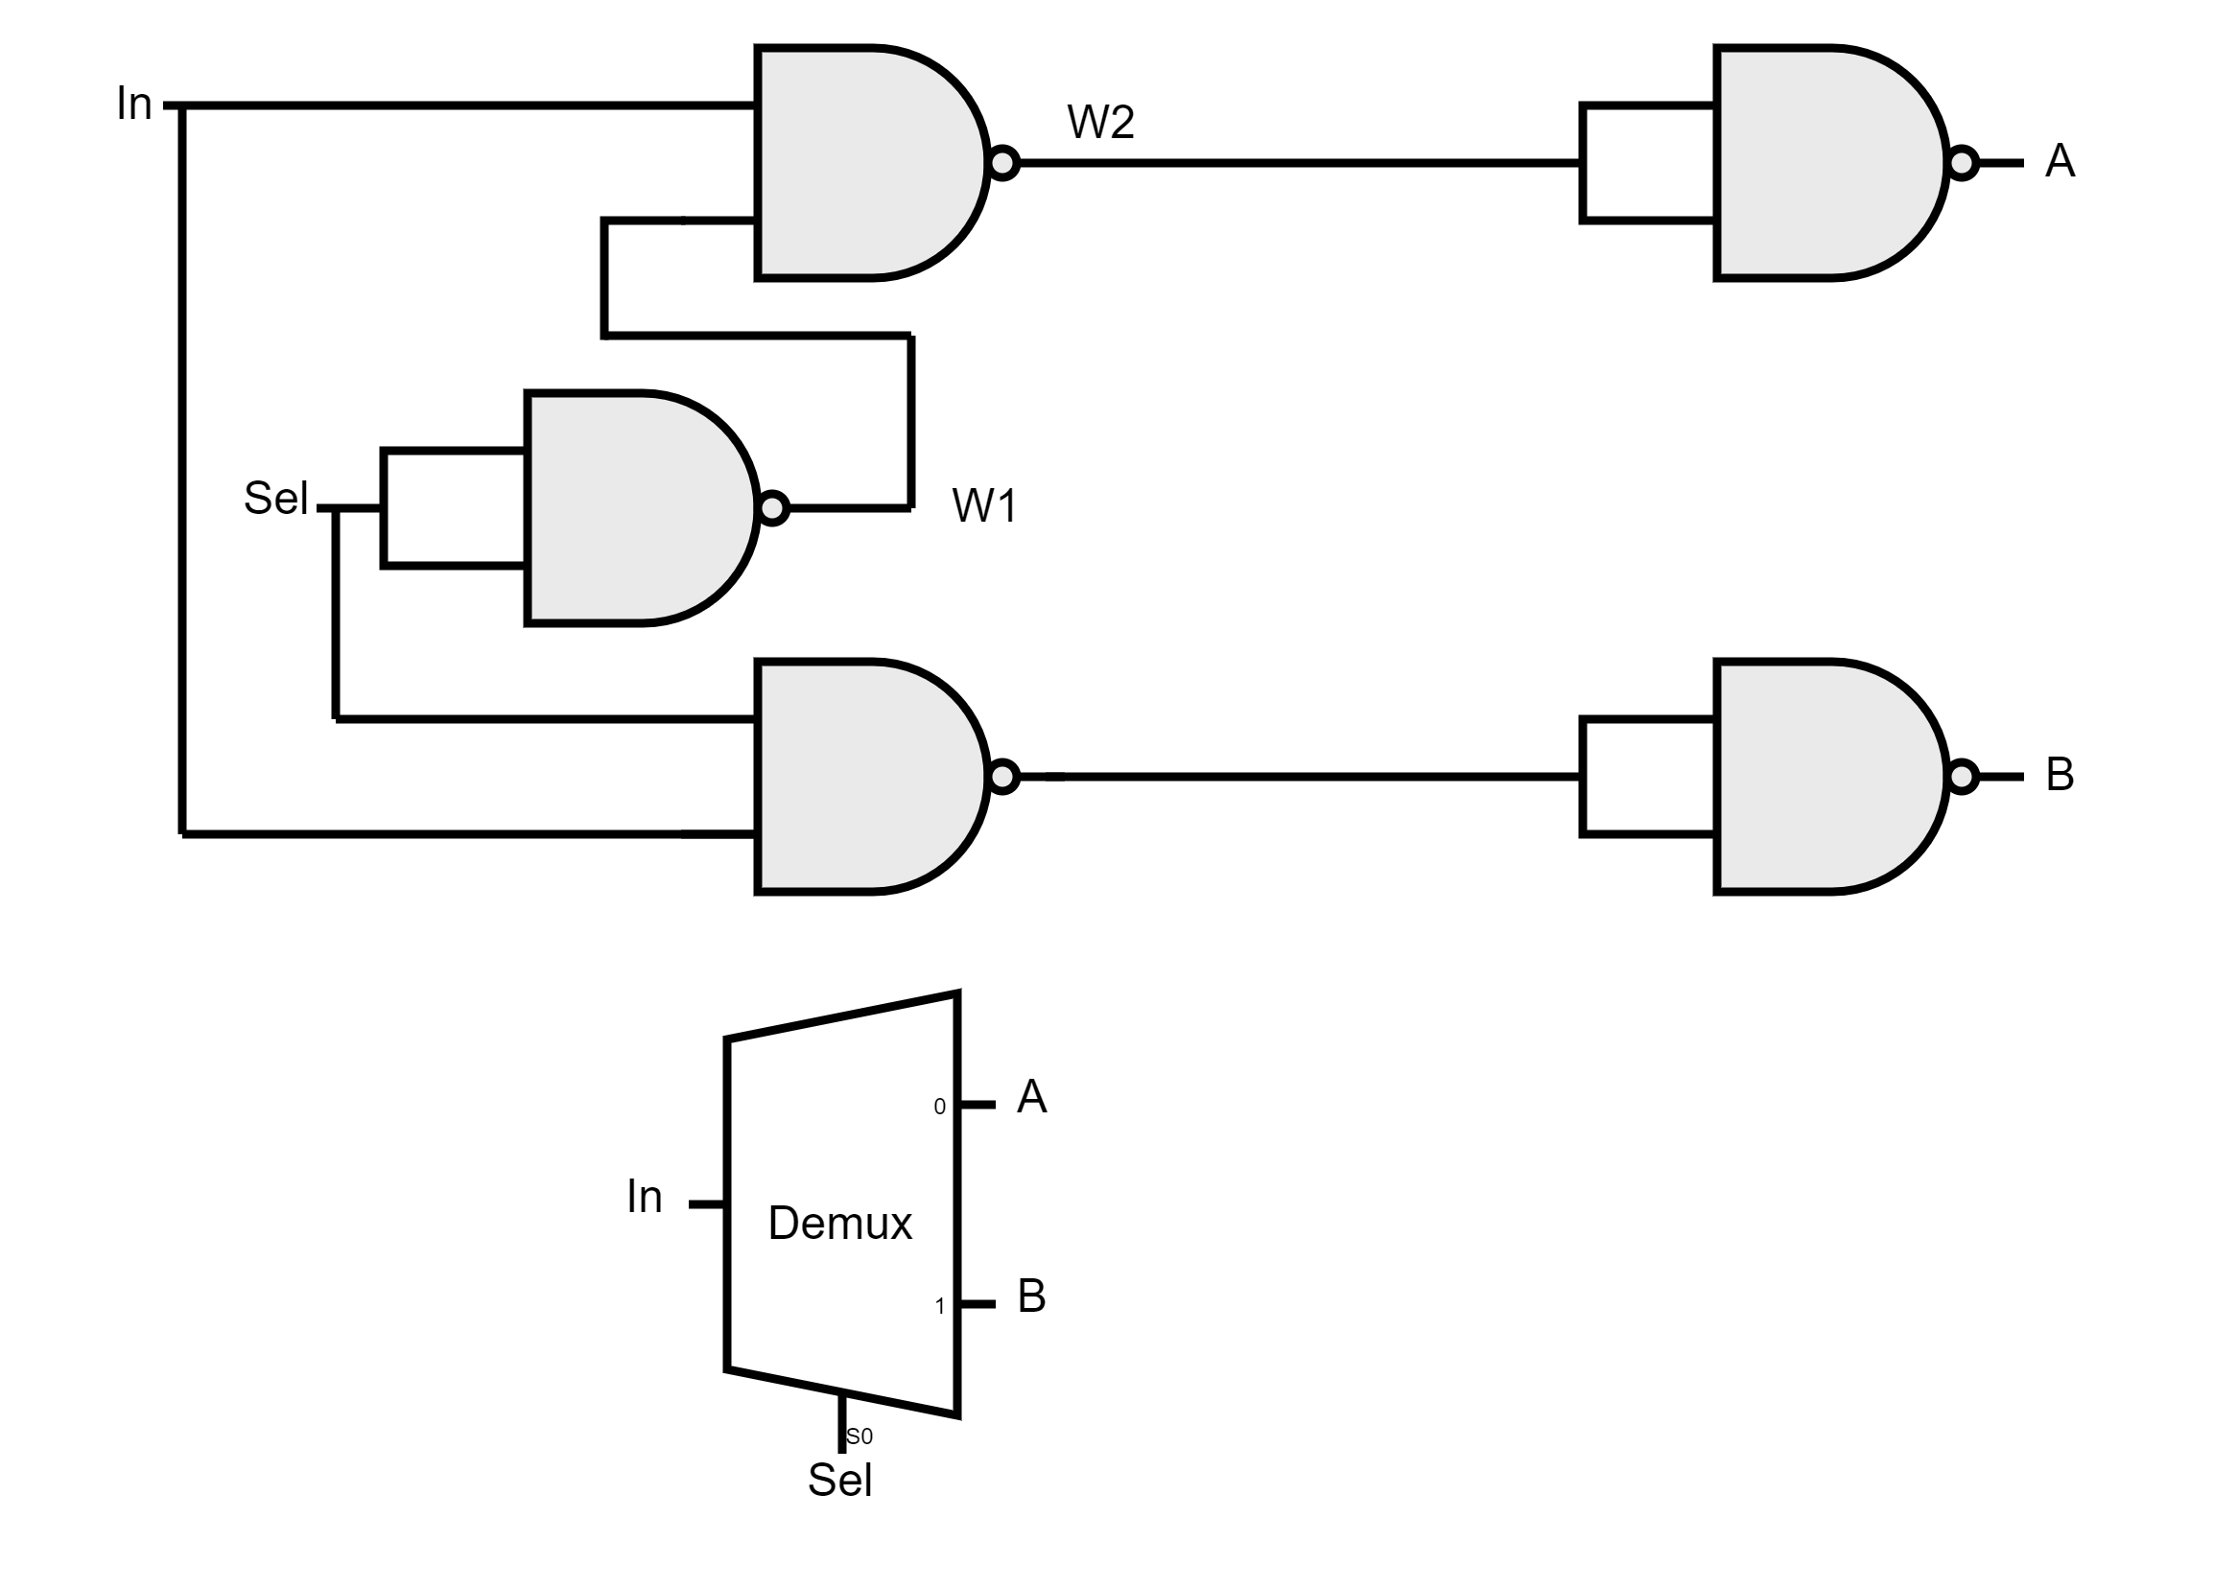
DMUX Gate
We build a DMUX using 5 NAND gates. We connect the input to one NAND gate with an inverted selecting line, and another NAND gate with a non-inverted selecting line. At the final stage, we connect each result to an inverter NAND gate.

Slide 37
16-bit Variants
Basic gates with 16-bit input

Slide 38
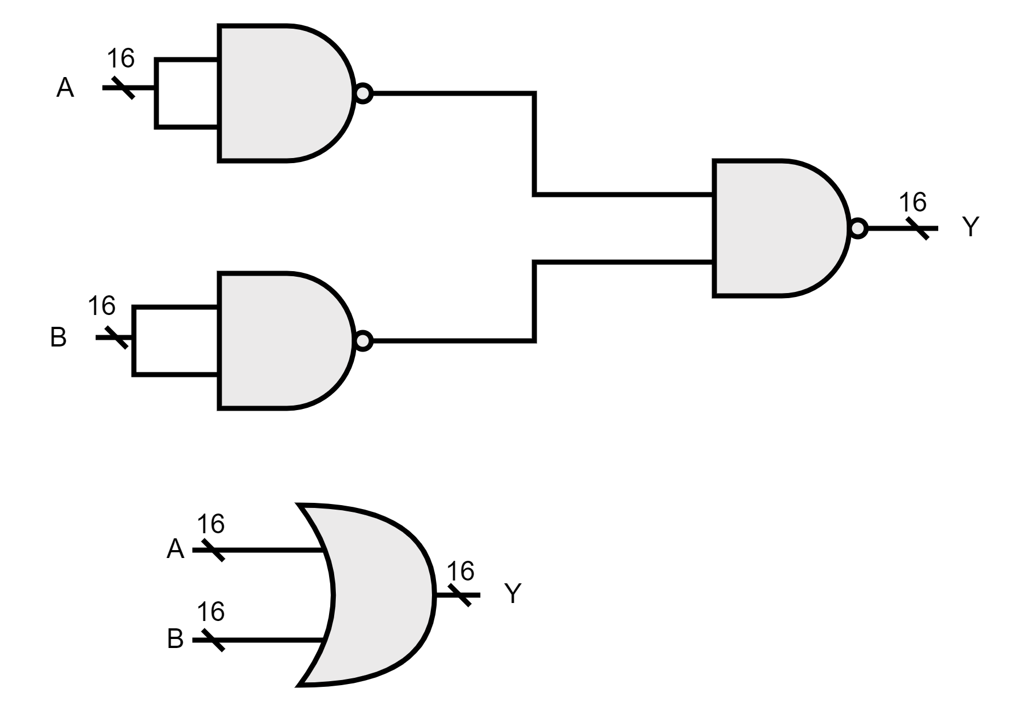
OR 16-bit Gate
We build OR16 by taking the 16-bit inputs through NOT gates and then pass their outputs through another NAND gate.

Slide 39
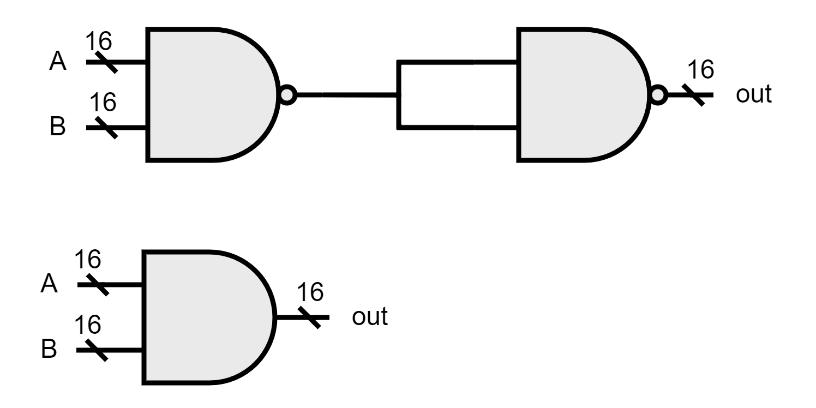
AND 16-bit Gate
We build a 16-bit AND gate by connecting the two inputs A and B to a NAND gate and then connecting the result to both inputs of the NAND gate.

Slide 40
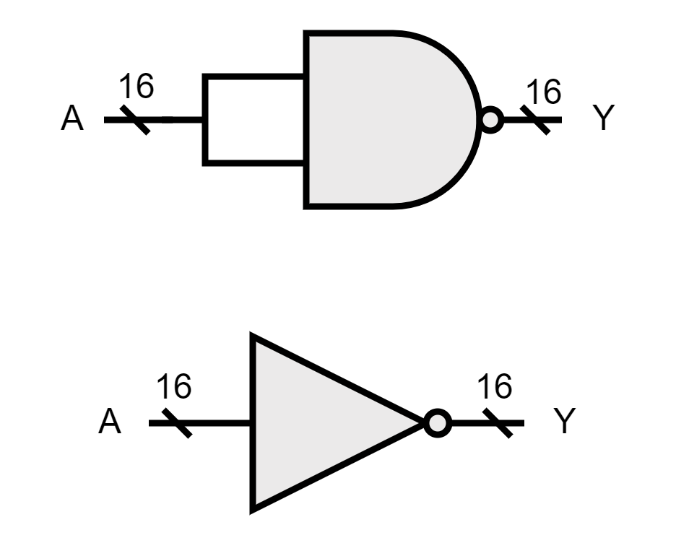
NOT 16-bit Gate
We build a 16-bit NOT gate by connecting both inputs of NAND gate to the input signal.

Slide 41
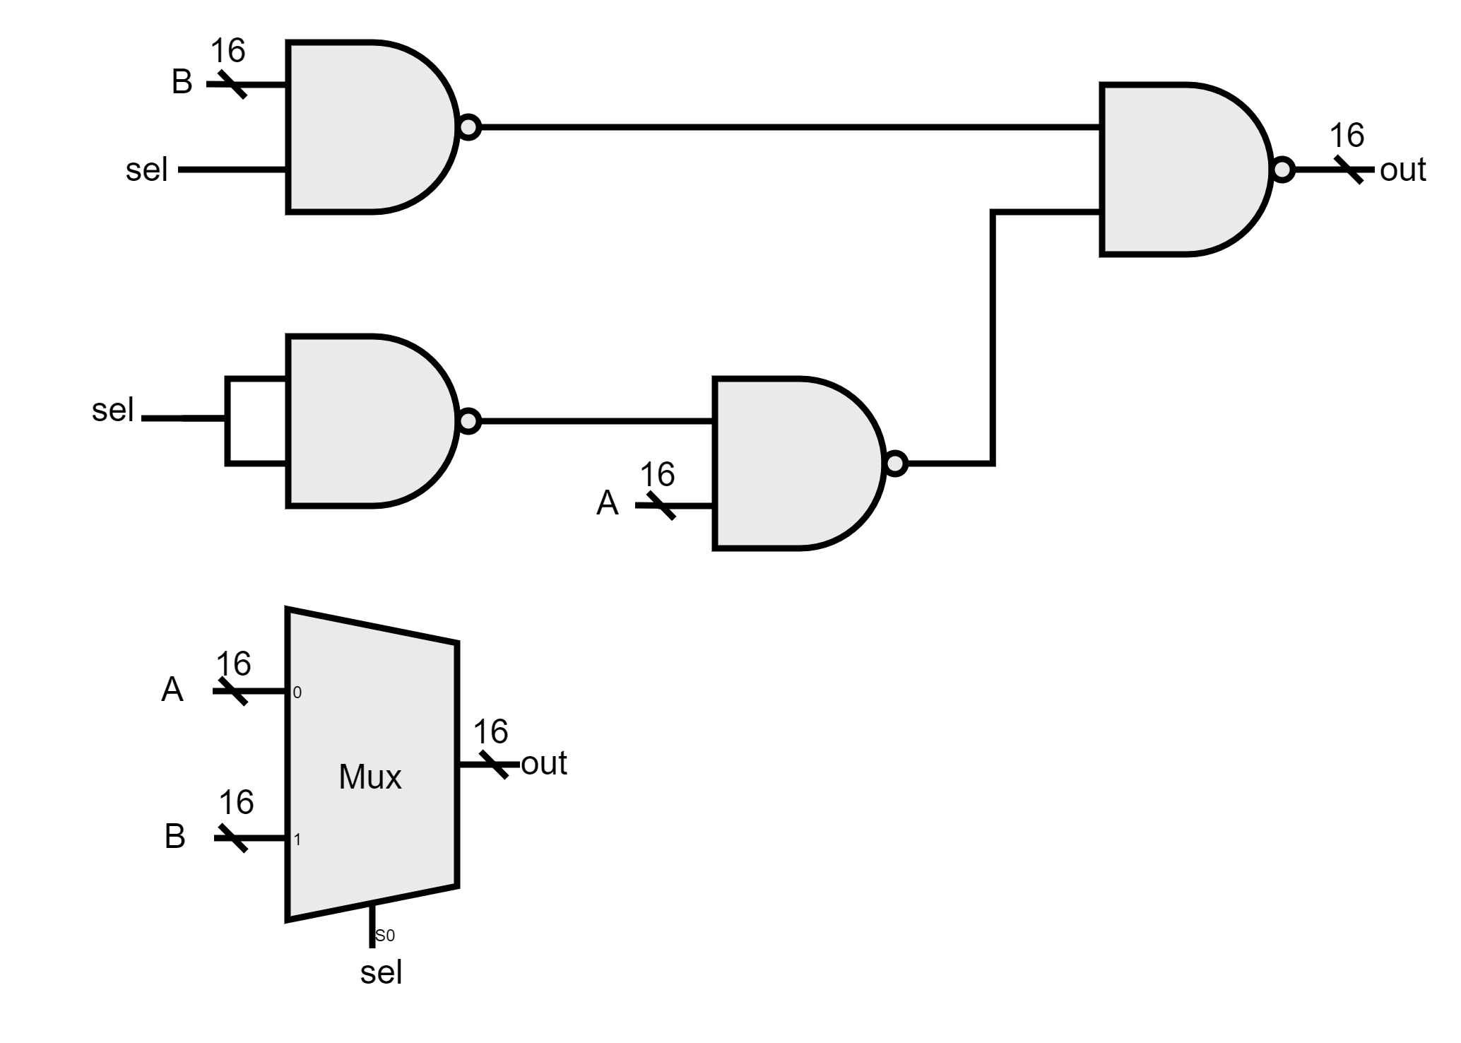
MUX 16-bit Gate
We build a 16-bit MUX using 4 NAND gates. We connect A to an inverted selection line, and B to a non-inverted selection line, and then combine the results using another NAND gate.

Slide 42
Multi-way Variants
Basic gates with 16-bit input

Slide 43
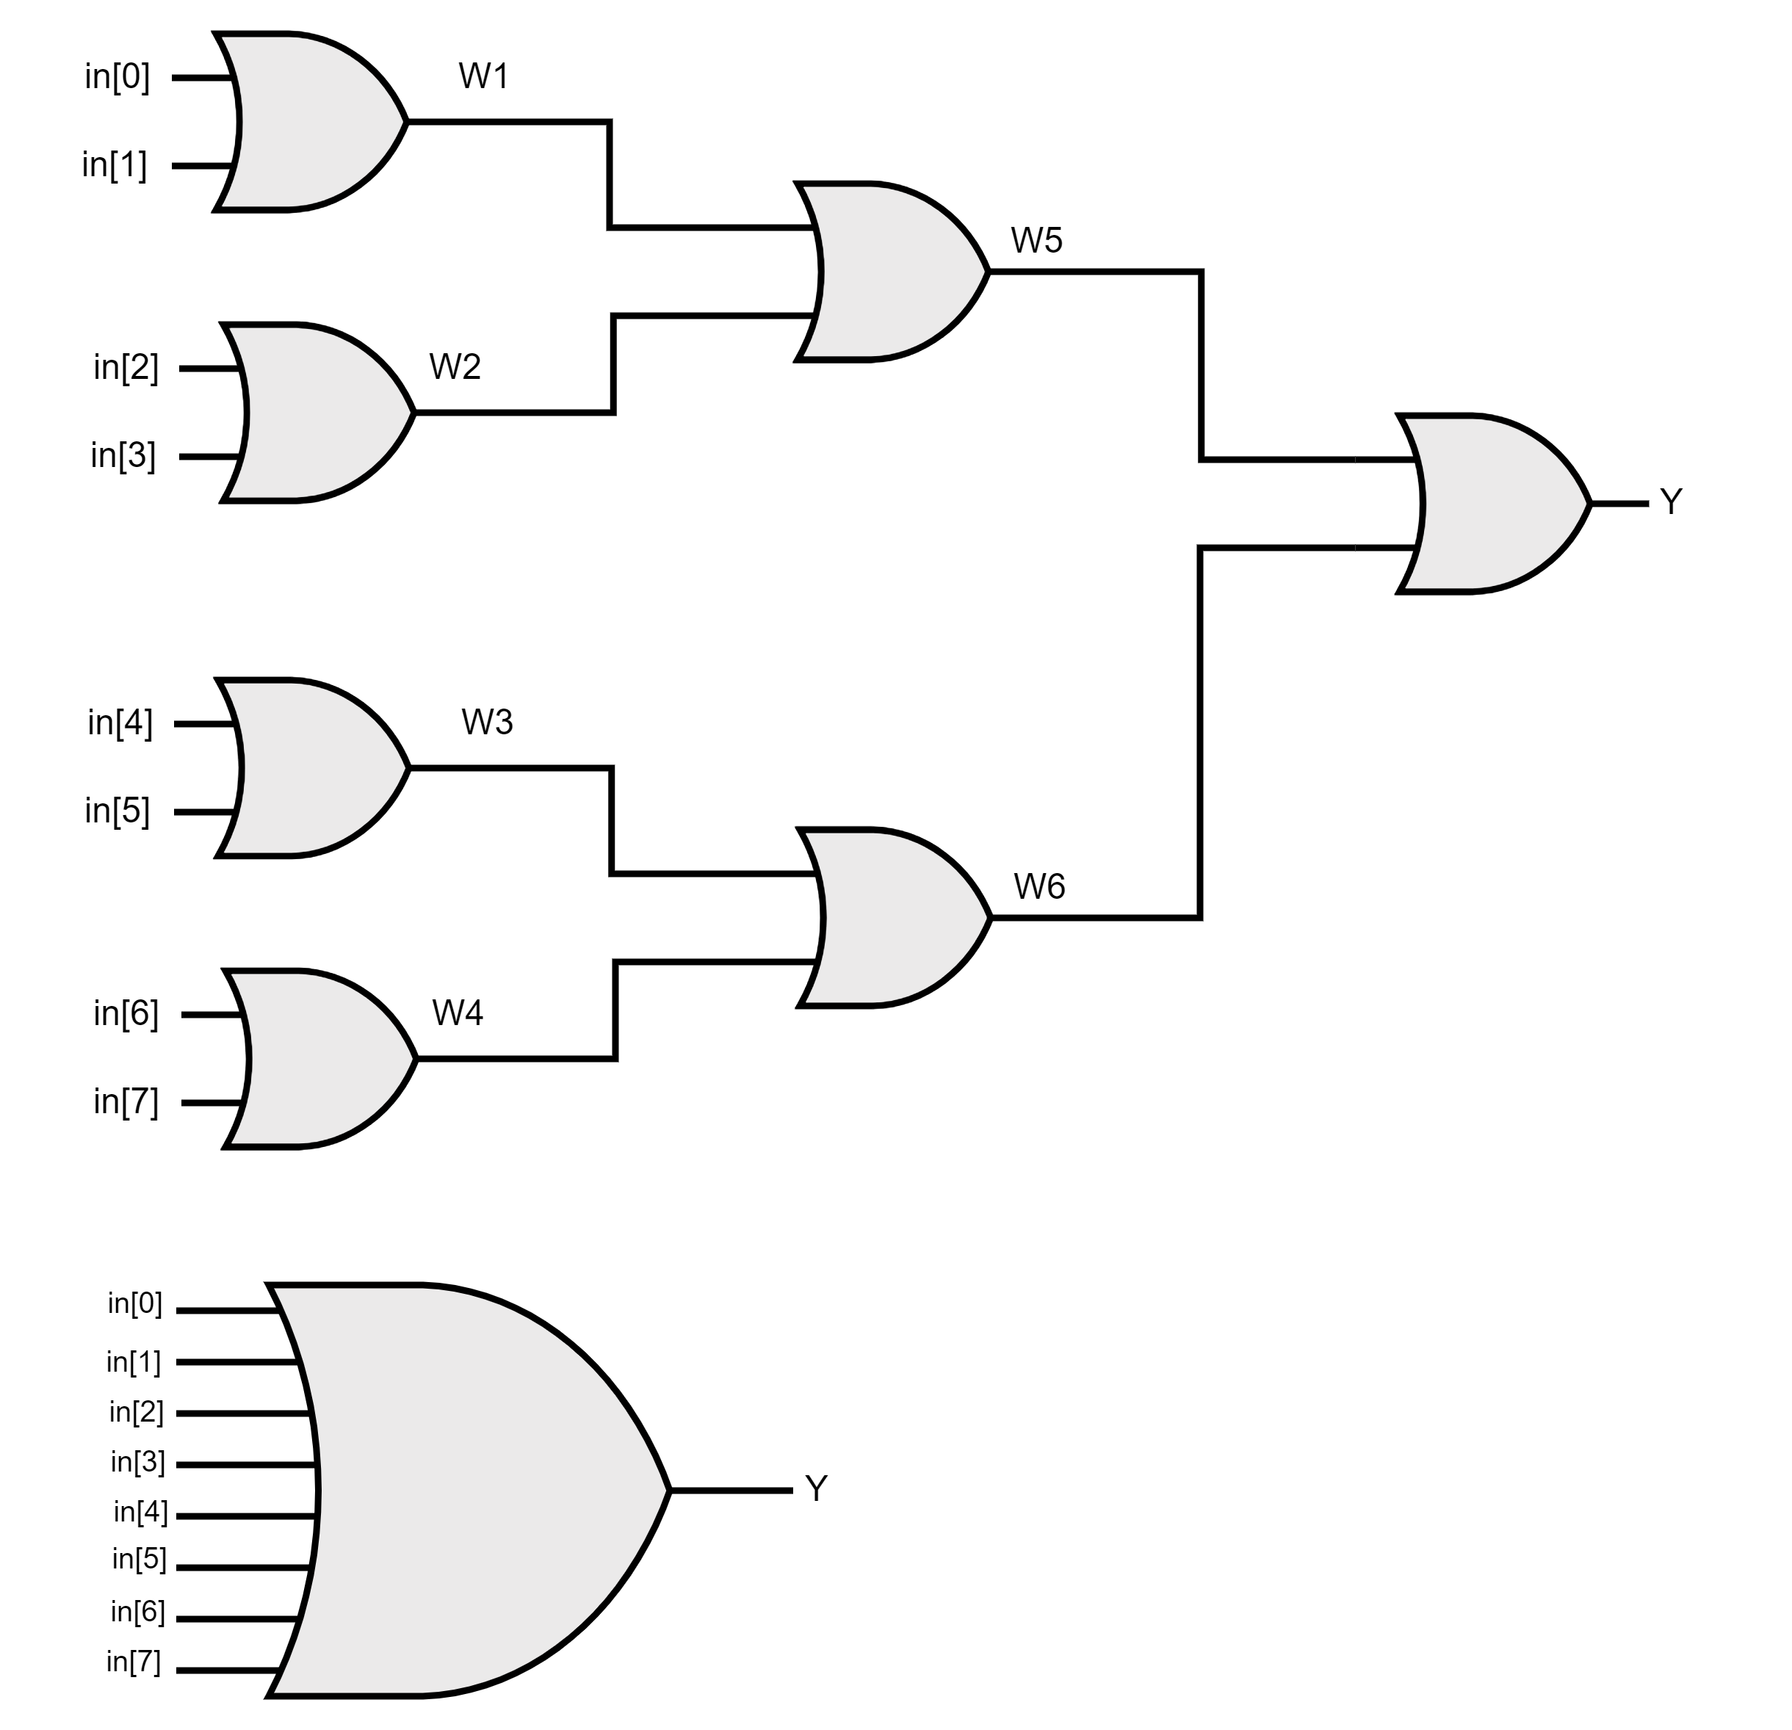
OR8Way Gate
We use 7 elementary OR gates to build OR8WAY. Each OR gate has 2 inputs, with 4 of them comparing the inputs and the other 3 comparing the outputs.

Slide 44
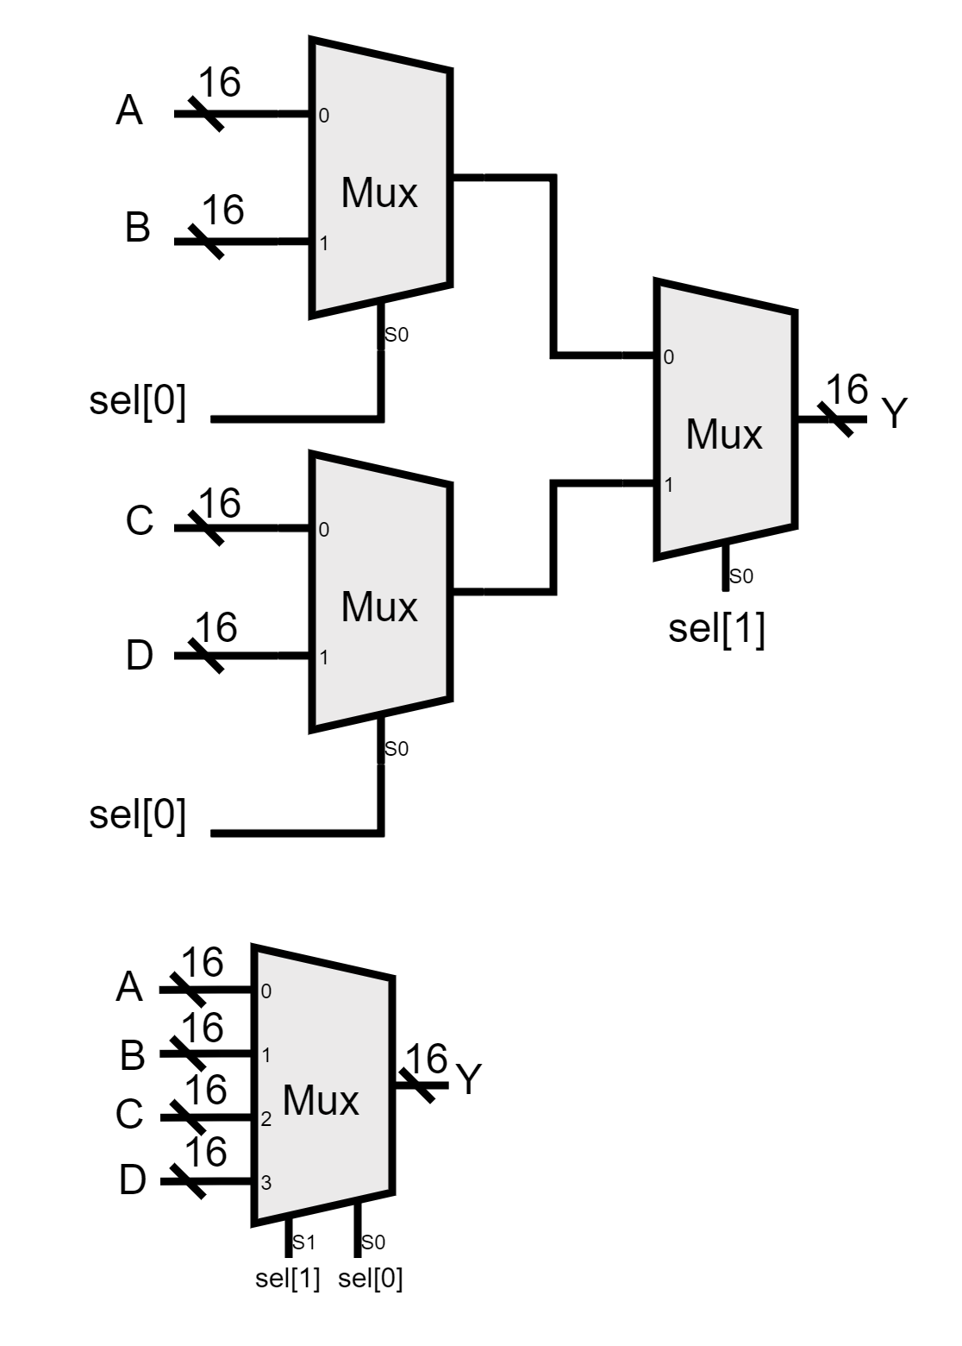
MUX4WAY Gate
We build MUX4WAY with 3 2:1 MUXs each MUX selects one of two inputs based on the selection line bit 0 and then selects one of the two results based on the selection line bit 1.

Slide 45
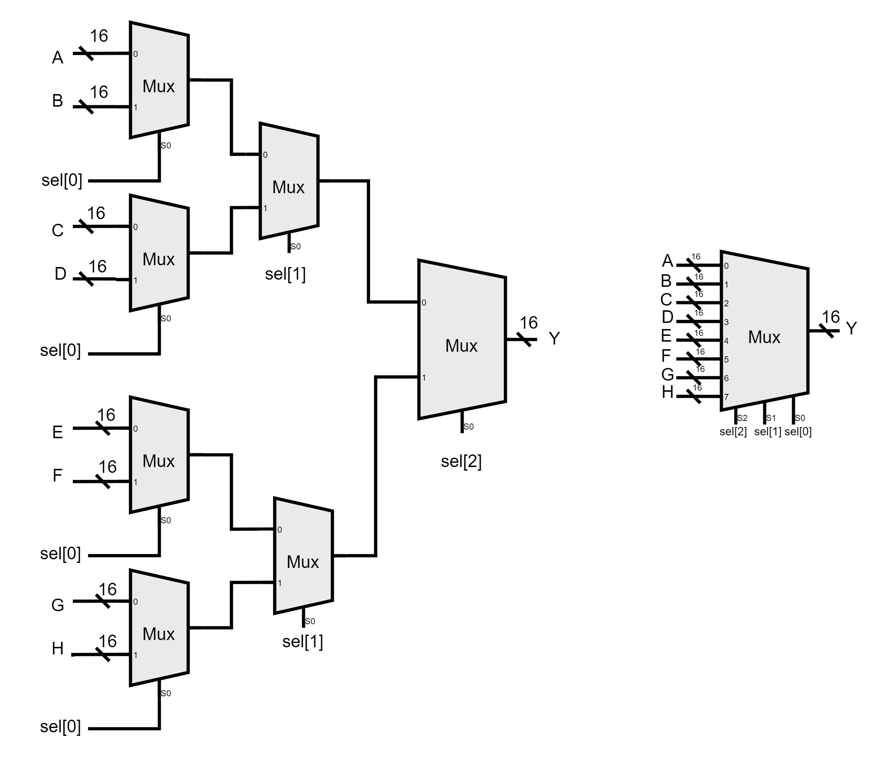
MUX8WAY Gate
We build MUX8WAY with 7 2:1 MUXs each MUX selects one of two inputs based on the selection line bit 0 and then selects one of the 2 results based on the selection line bit 1 at the last stage it selects one of the results based on the selection line bit 3.

Slide 46
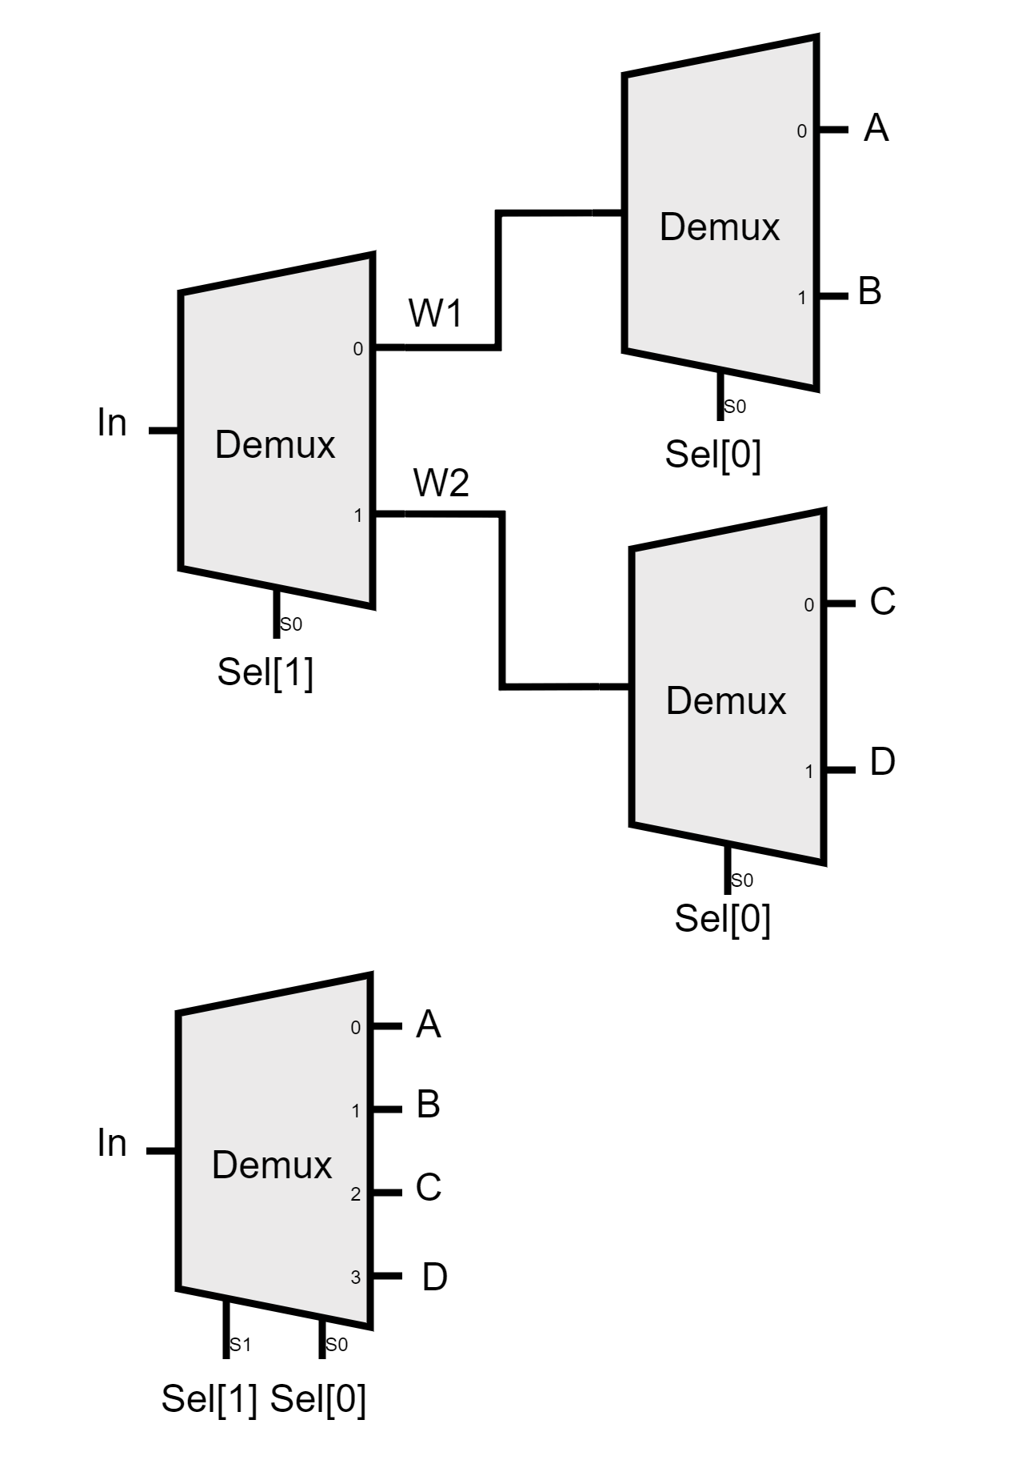
DMUX4WAY Gate
We build a DMUX4WAY with 3 2:1 DMUXs, where the input is split into two paths based on the selection line to display the input on one of the outputs.

Slide 47
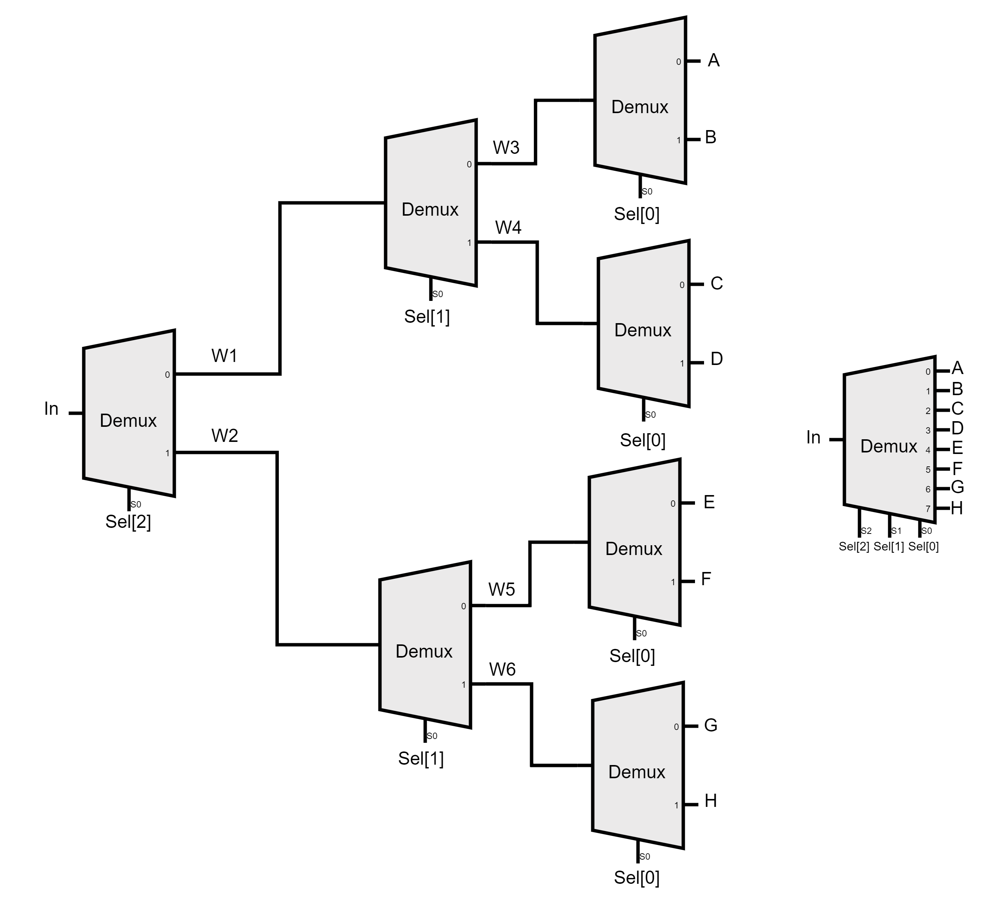
DMUX8WAY Gate
We build a DMUX8WAY with 7 2:1 DMUXs, where the input is split into two paths based on the selection line to display the input on one of the outputs.

Slide 48
Our Roadmap :
Phase 01
Phase 02
Phase 03
Phase 04
Design the architecture
Hardware implementation
Software implementation
Game or application

Slide 49
What to excpect in the future
Assymbly code design
Compilers design
Serial comminication design
Debugger design
Application or game demo

Slide 50
Thanks!

